Slide 1
From commercial success to neoliberal fiasco:
The social impact of gas extraction in the province of Groningen
Cedla in Stad
Agustín De Julio

Slide 2
Earthquakes Europe’s gas field | Aardbevingen Groningen | Erdbeben Europas Gasfeld (dwarshuis.com)

Slide 3
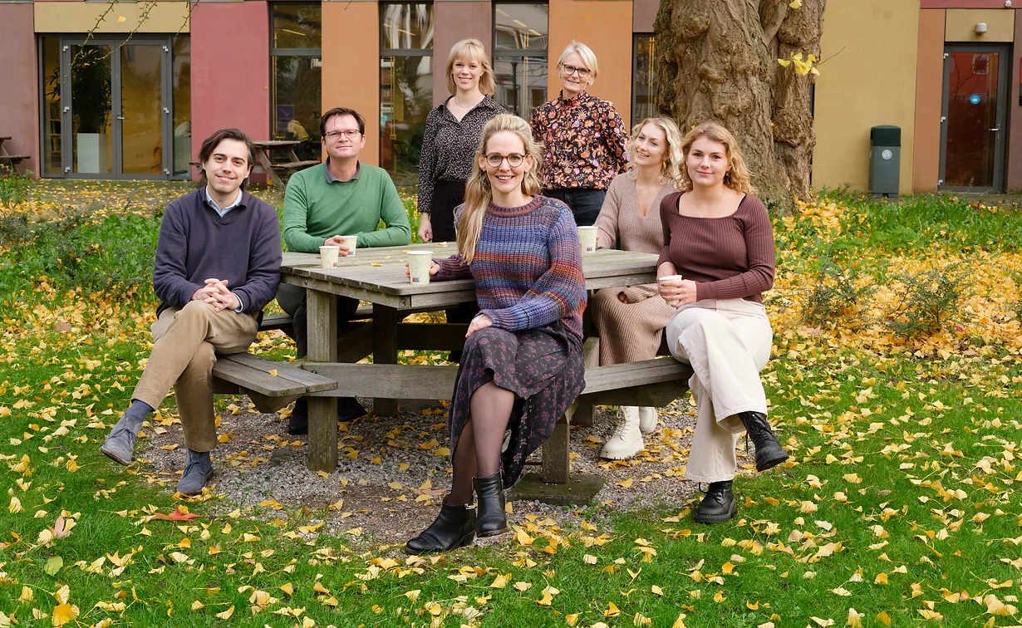
About me
This PhD:
Transitional justice
Reconciliation
Groningen history and culture

Slide 4
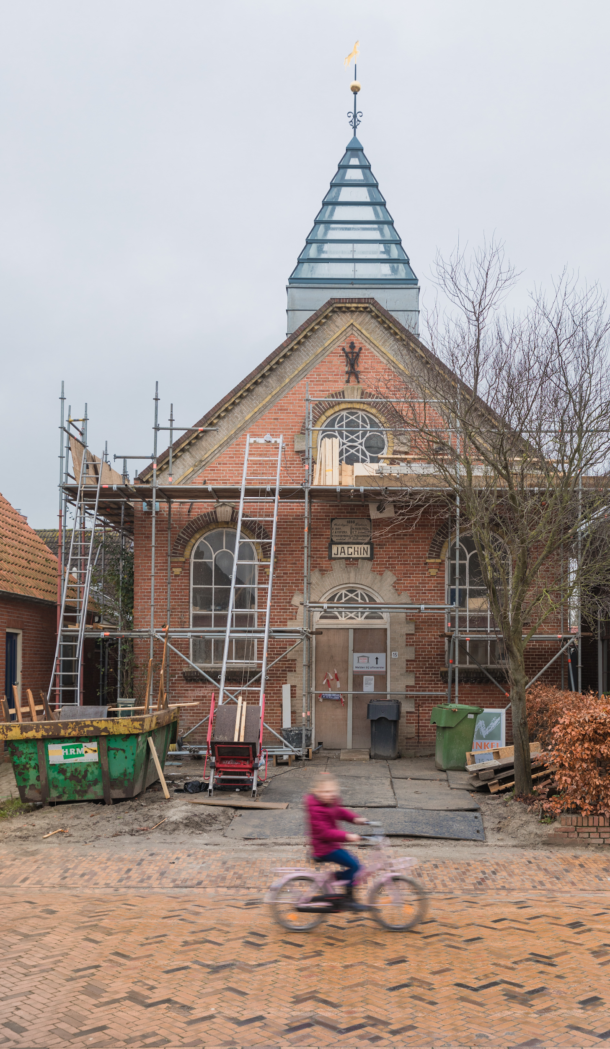
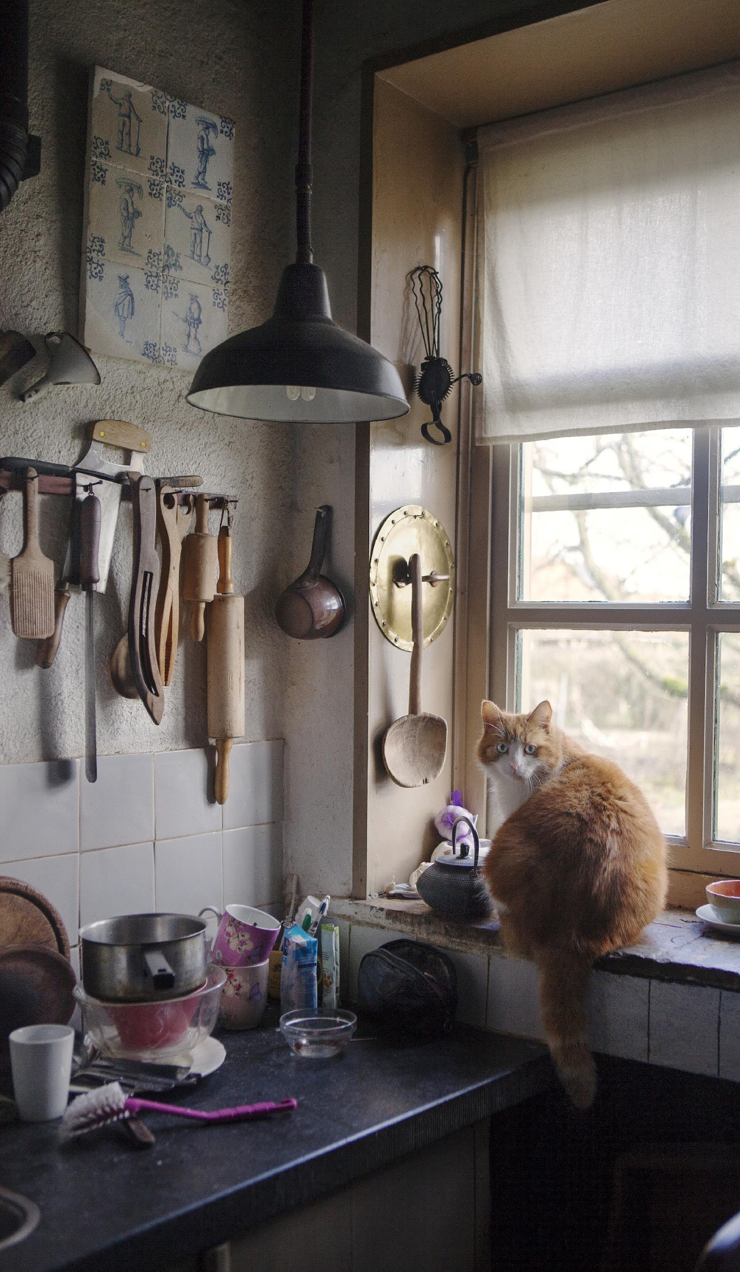
The Knowledge Platform
Social impact of mining and energy projects

Slide 5
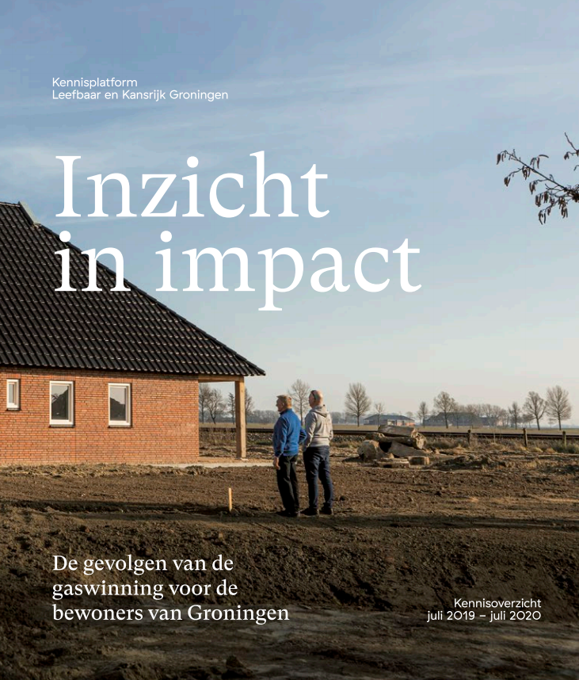
The Knowledge Platform
3 themes:
Societal impact
Recovery
Lessons
https://en.kennisplatformleefbaar.nl/stand-van-kennis-2021

Slide 6
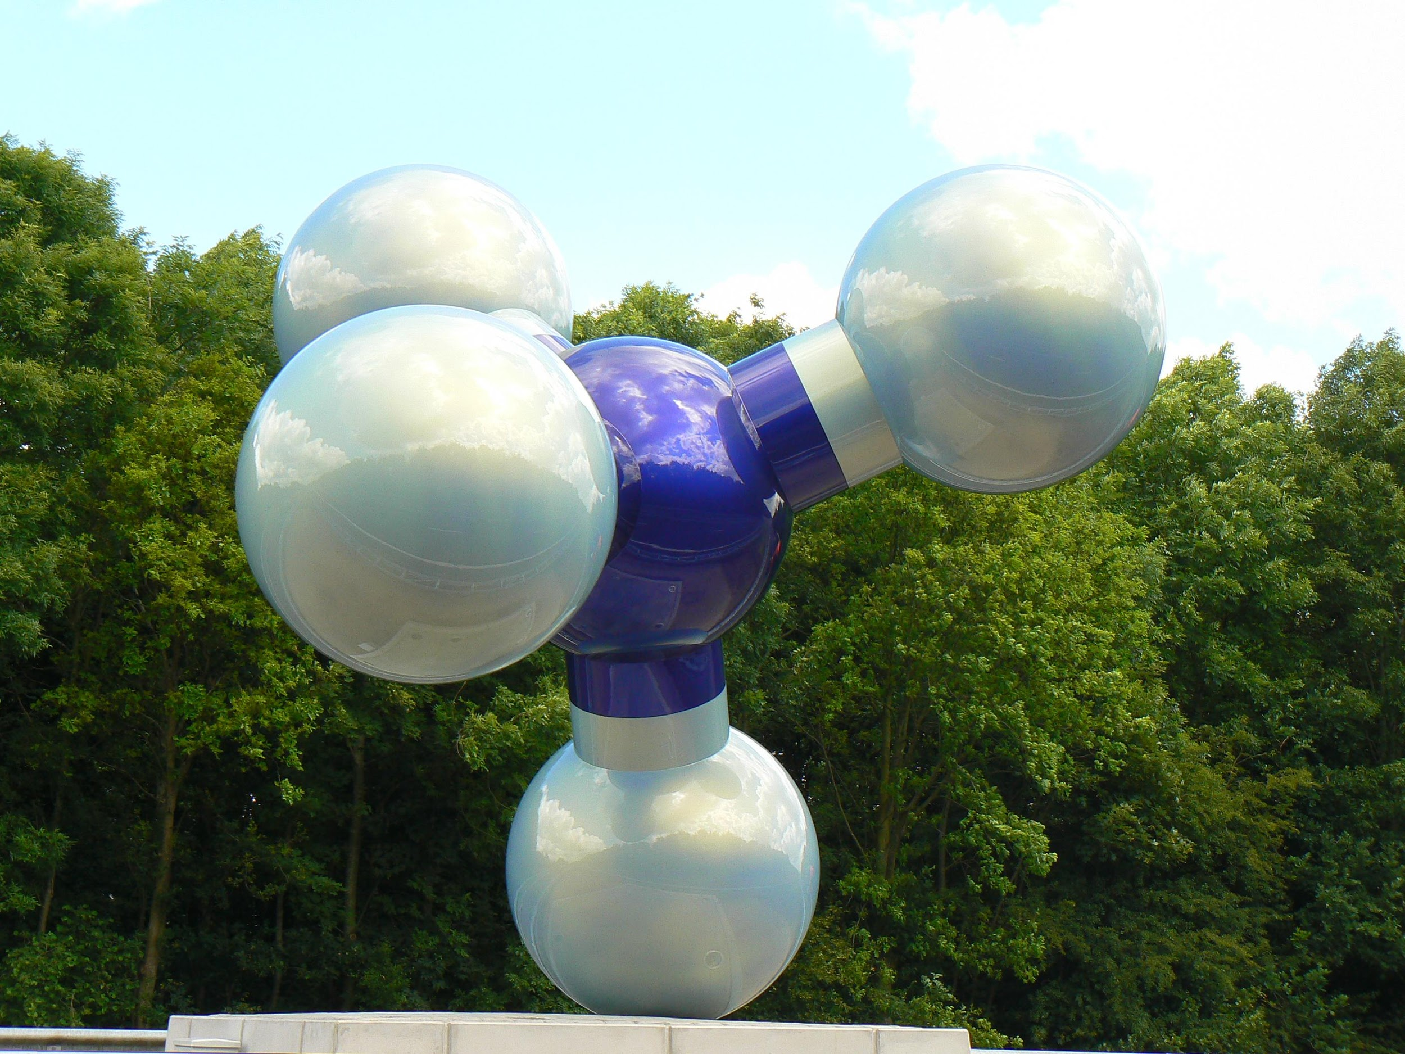
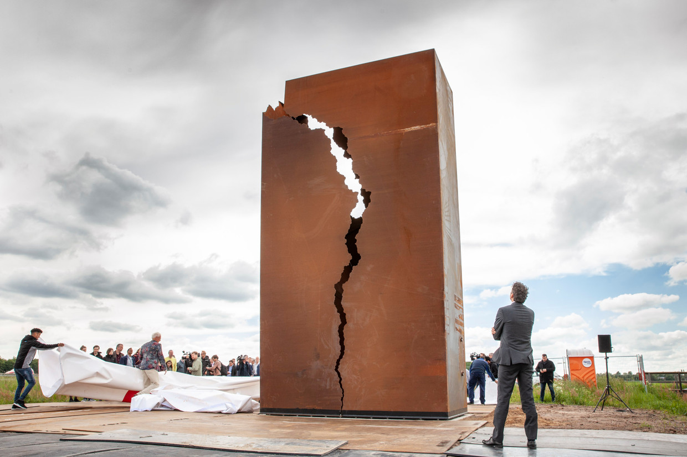
Setting the scene
2009: Artwork celebrating the 50 years of gas extraction in the Province of Groningen.
2019: Artwork symbolising the negative impact of the gas extraction.

Slide 7
This presentation
The Groningen gas field
Societal impact of the gas extraction
Lessons learned and challenges ahead
The Parliamentary Inquiry

Slide 8
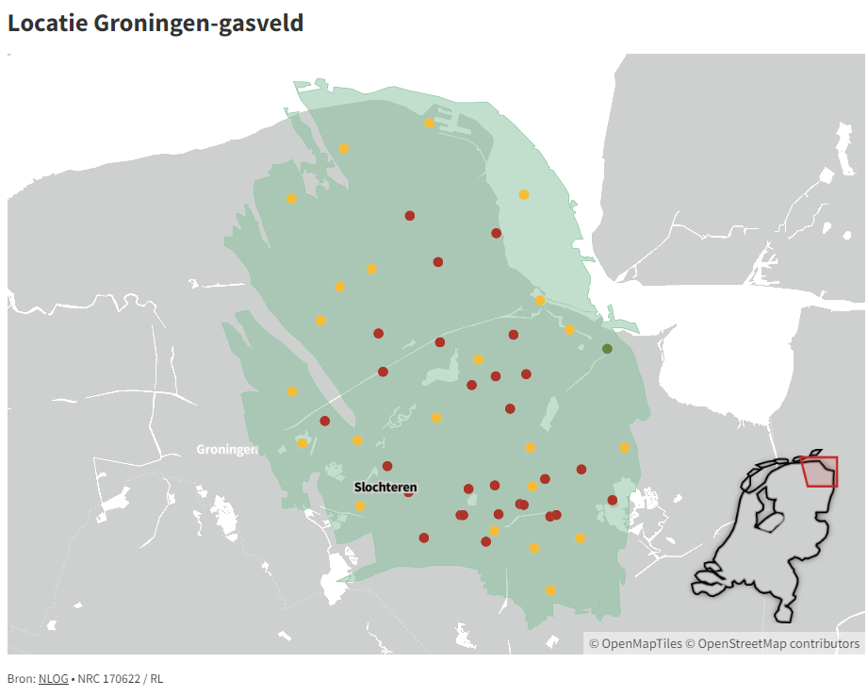
History and characteristics
Credit: NRC, 2022

Slide 9
History and characteristics
1959: The Groningen gas field discovered.
1963: start commercial production
The Groningen field:
3 km depth, in a porous layer of sandstone.
900 km²
2740 billion m³ gas
Top 10 gas fields - biggest of Europe.
More than 80% depleted (Shell, 2023)

Slide 10
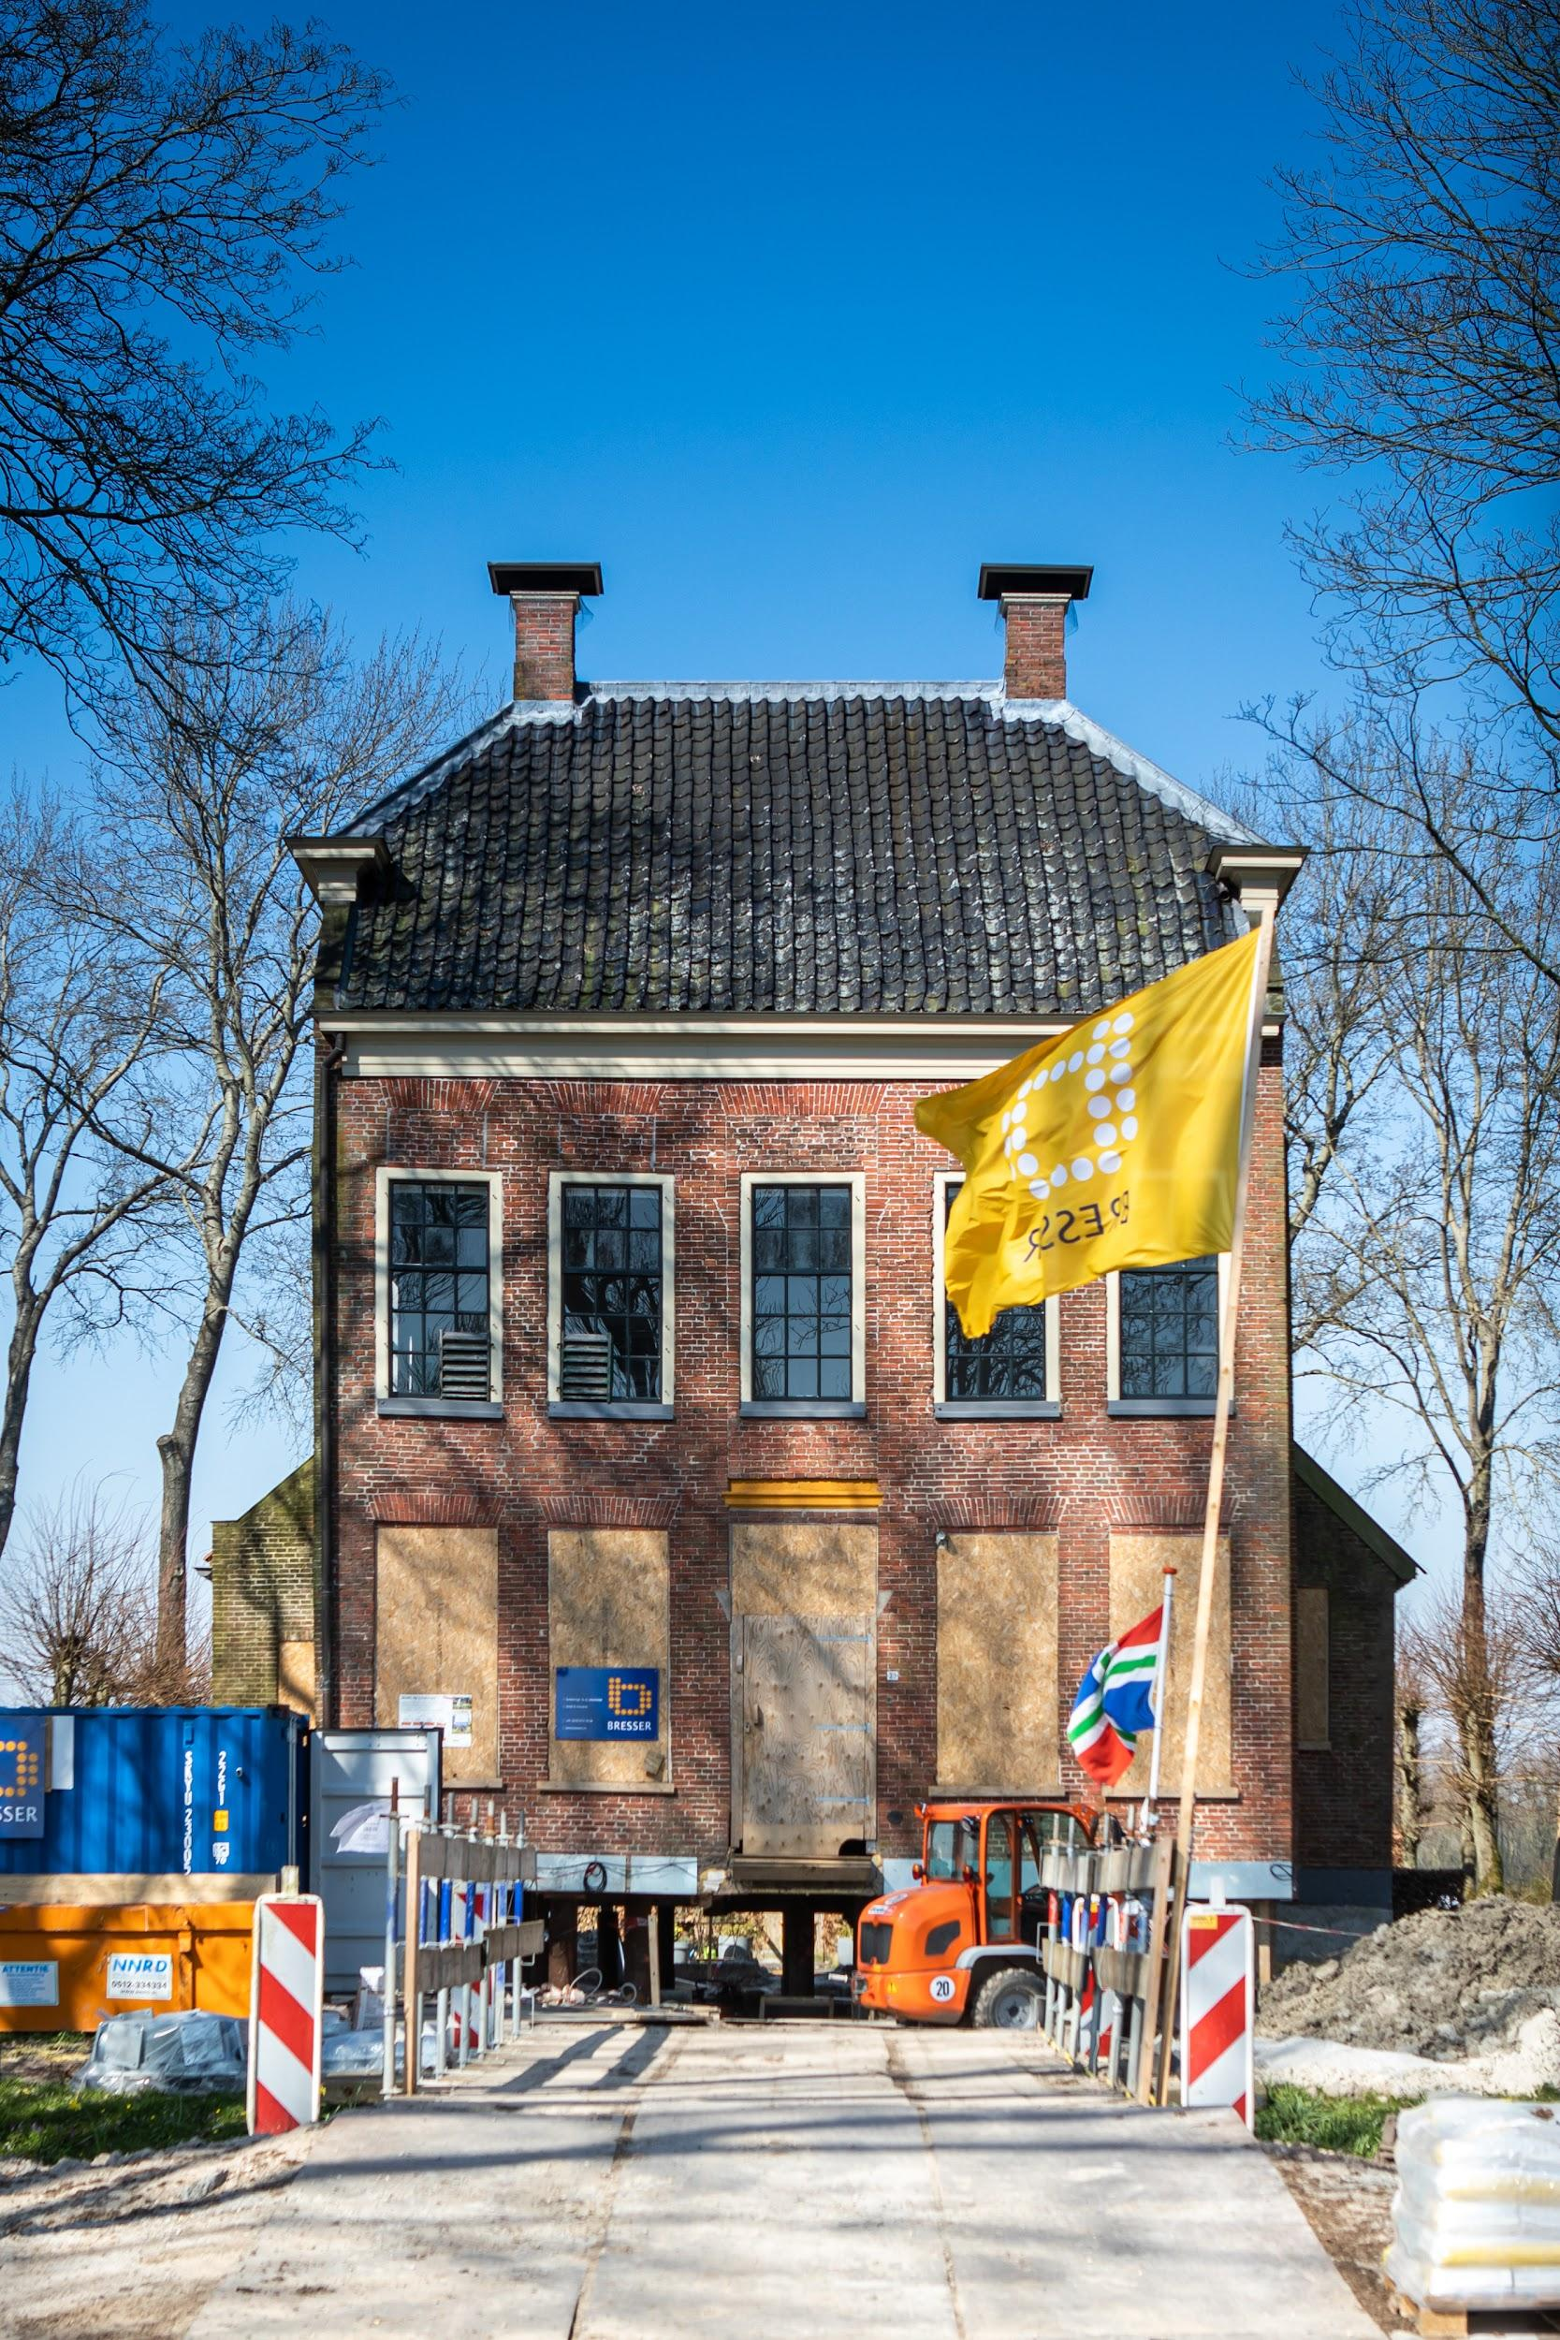
History and characteristics
Relatively low extraction costs
Densely populated (410000 people in seismic area)
Operated by public private partnership of Shell, Exxon and State
These share profits:
Revenues national government
sale of gas;
share in NAM profits;
royalties;
taxes and fees;
dividends.
(Van der Voort & Vanclay, 2015)

Slide 11
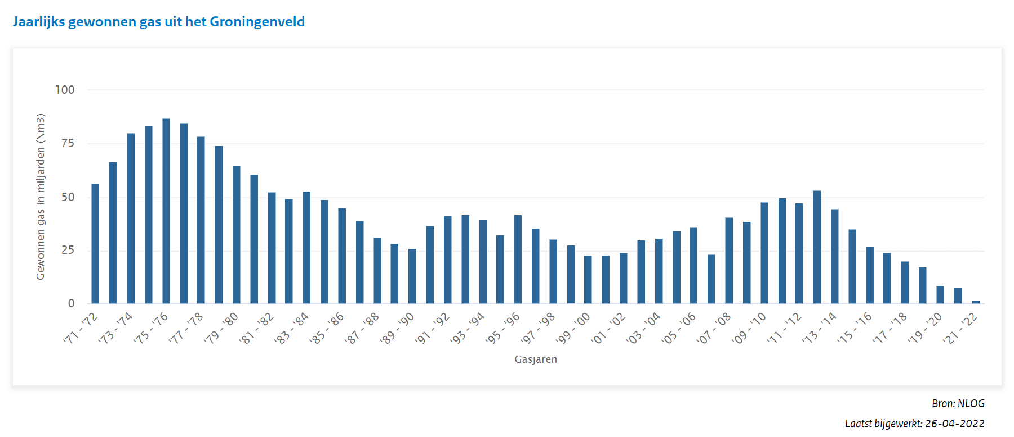
Benefits and wealth

Slide 12
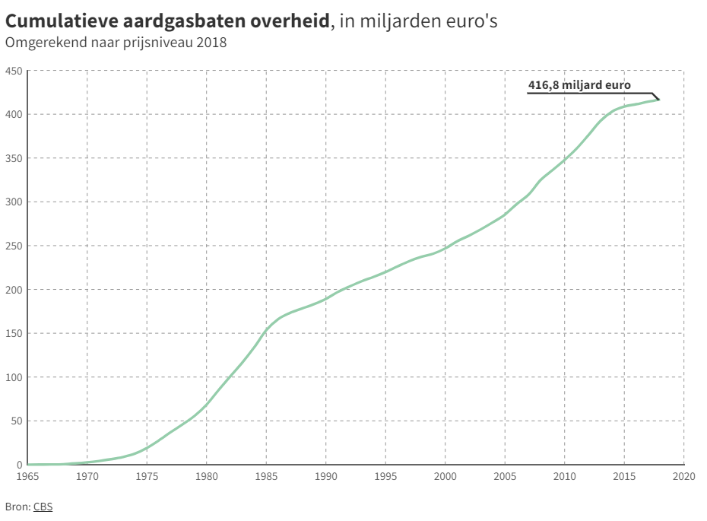
Benefits and wealth
Credit: NRC, 2022

Slide 13
Benefits and wealth
Large infrastructural works paid from revenues.
Only 1% to Groningen (Instituut voor Onderzoek Overheidsuitgaven, 2006).
Caused the economic phenomenon called 'Dutch Disease’.
Source: Nieuwsblad van het Noorden, 1960

Slide 14
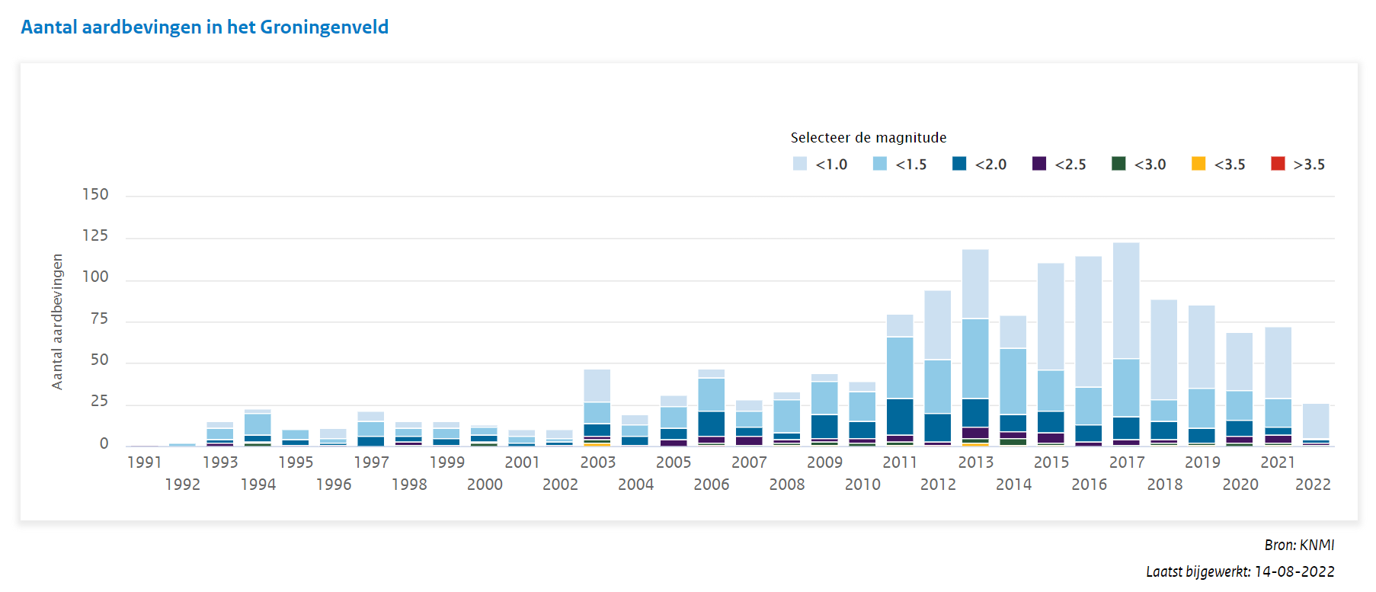
Earthquakes and soil subsidence

Slide 15
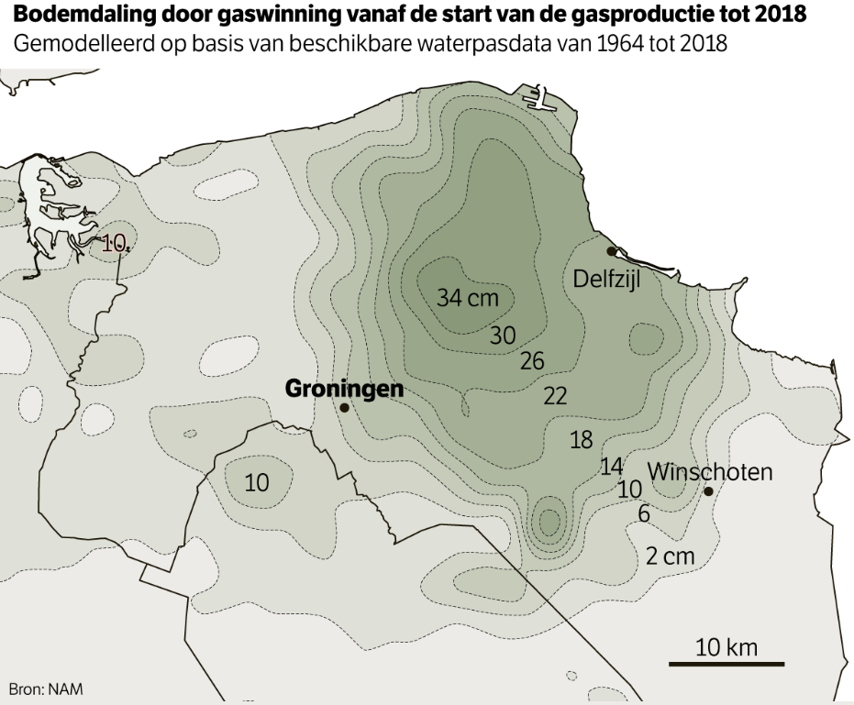
Earthquakes and soil subsidence
Credit: NRC, 2022

Slide 16
Damages, unsafety and controversy
Earthquakes are not part of the traditional hazardscape of the Netherlands (Bakema et al., 2018).
Early warnings…
1963: engineer Willem Meiborg
1986: first earthquake.
1986: Geographer Meent van der Sluis
…
2022: parliamentary inquiry committee shows how insights of many scientists were ignored and manipulated for decades (PEAG, 2022).

Slide 17
Damages, unsafety and controversy
Denial by NAM and Dutch government:
1. Causal links gas extraction and earthquakes.
2. Earthquakes cause damage.
3. Earthquakes cause safety issues.
2009: Groninger Bodembeweging established to represent the interest of residents.
2012: turning point is an earthquake with M3,6 on the Richter scale, epicenter is the village of Huizinge.

Slide 18
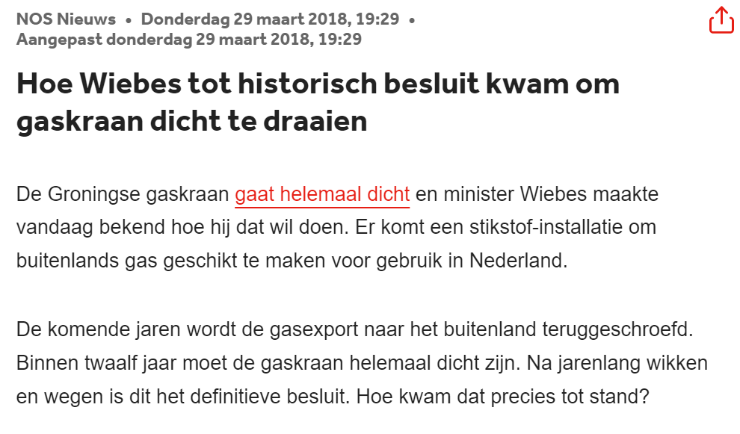
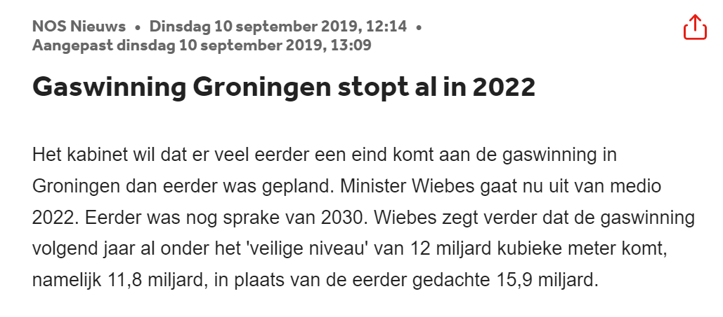
Damages, unsafety and controversy
Mitigation strategies
Identify buildings at risk + reinforcement.
Reduction gas extraction only in 2014.
2019 decision to stop gas extraction: either 2023 or 2024.
Responsibilities
NAM: damage repair and reinforcement.
> Not transparent and impartial.
2015: burden of proof changed.
2020: national government takes
over responsibility.

Slide 19
Damages, unsafety and controversy
GOVERNANCE
Safety - reinforcement
NAM > Centrum voor Veilig Wonen (CVW) > Nationaal Coordinator Groningen (NCG)
Damages, material and immaterial - compensation
NAM > CVW > Tijdelijke Commissie Mijnbouwschade Groningen (TCMG) > Instituut Mijnbouwschade Groningen (IMG)
Future perspective - investments
Nationaal Programma Groningen (NPG)

Slide 20
Current situation
Earthquakes
Gas extraction will stop in Oct ‘23 or ‘24.
Even if gas extraction stops, earthquakes may continue for decades.
Societal impact
Not merely a technical or financial problem, but a societal problem:
Bureaucracy, inequality and insecurities.
Constant changes in the institutional landscape make governance a problem (Bovenhoff et al., 2021).
Not recognizing the problems made it worse.

Slide 21
Material damage
a) Unsafety
b) Damages
c) The housing market and economic developments
2. Immaterial damage
a) Policies and communication
c) Health and wellbeing
Societal impact of the gas extraction

Slide 22
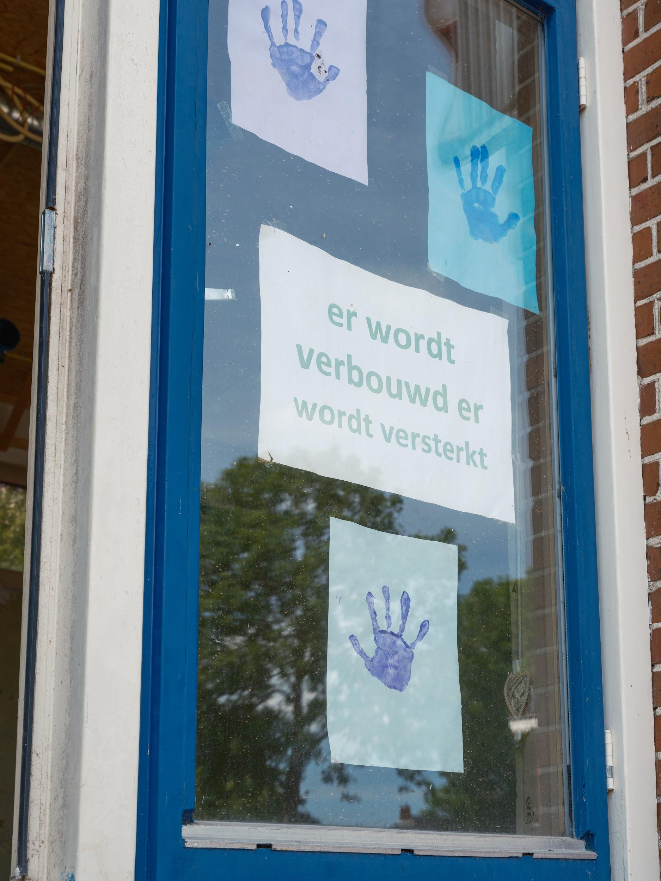
Material impact
410,000 residents exposed to induced earthquakes.
Buildings are unsafe and/or damaged:
houses, schools, churches etc
Buildings need fortification and/or damage repair.
Approach:
Focus on technical solutions.
Inspection costs €10.000 - €100.000 (reinforcement).
60-70c per euro spent go to bureaucracy.

Slide 23
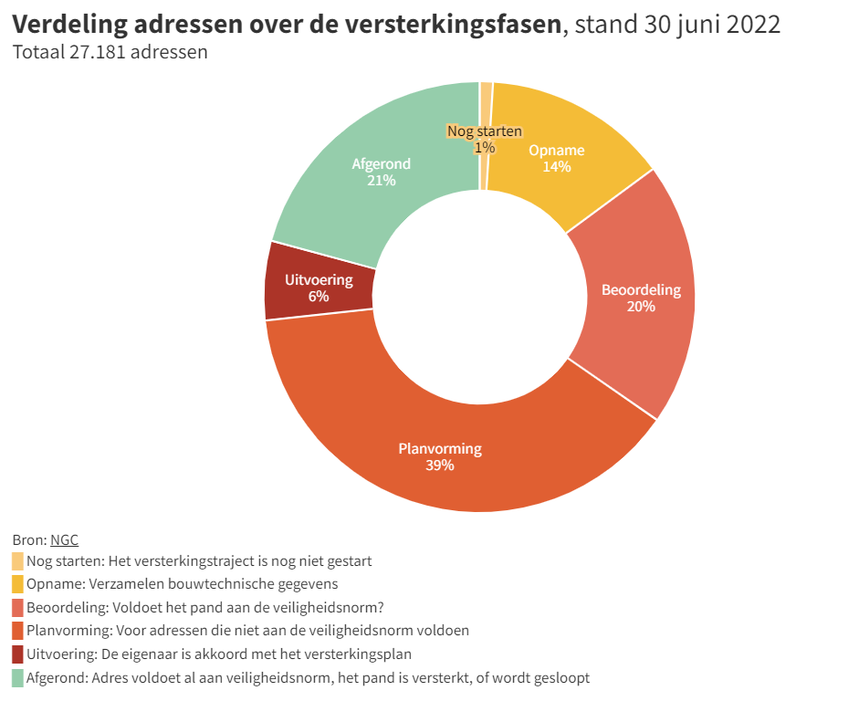
Unsafety
More than 27.000 buildings need to be inspected.
Discrepancy between predictions from models and the outcomes of inspections.
Credit: NRC, 2022

Slide 24
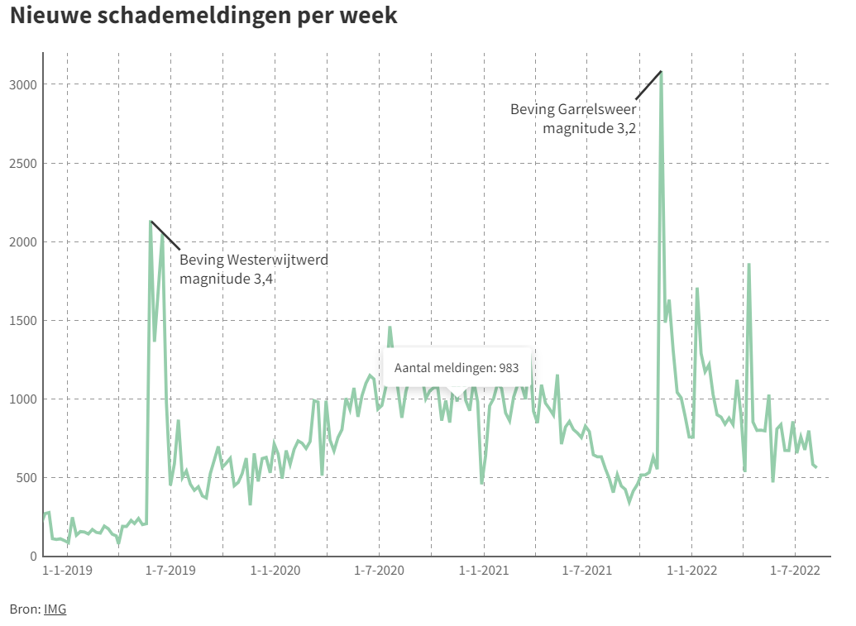
Damages
New damages claims, especially after earthquakes.
20.000 damage claims still pending.
2,5 years before decision on damages is made.
(See Dagblad van het Noorden, November 7, 2022.)
Responsible: Instituut Mijnbouwschade Groningen (IMG)
Credit: NRC, 2022

Slide 25
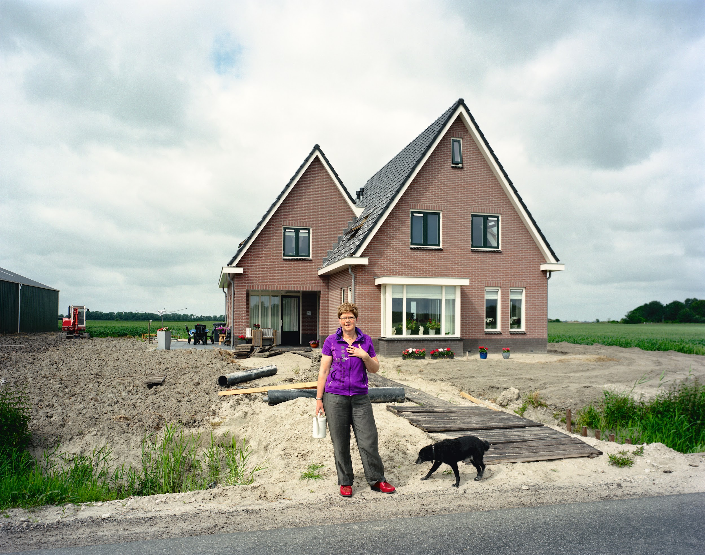
The housing market and economic impact
Distorted housing market.
Investments in the region.
Economic impact on households.

Slide 26
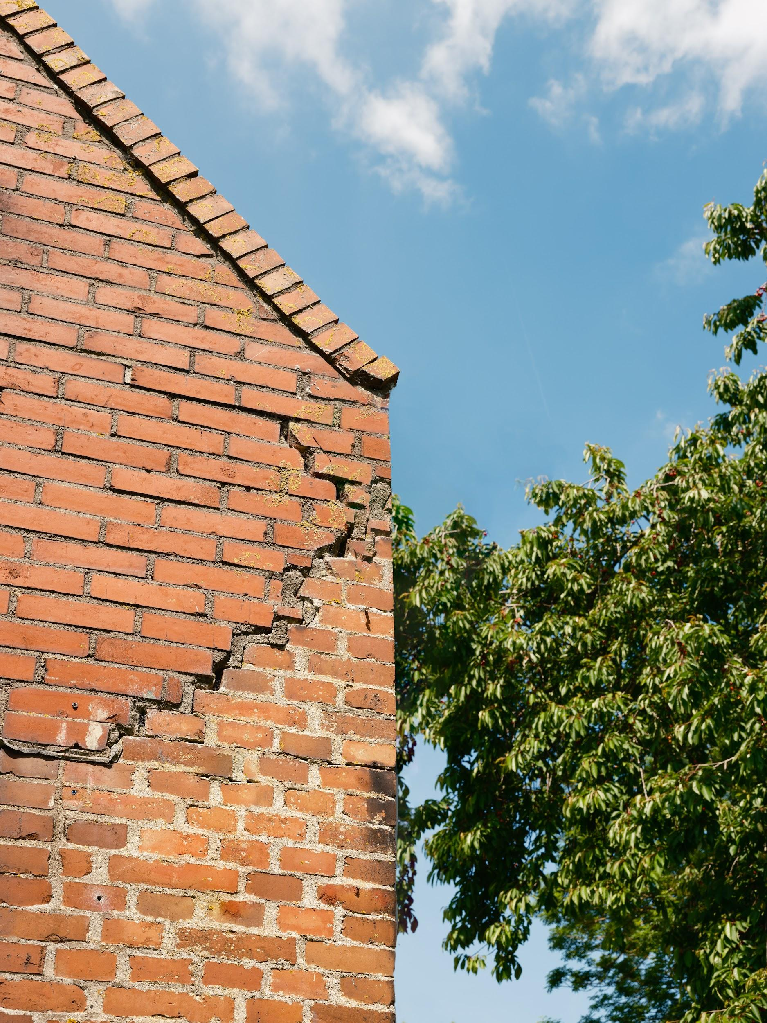
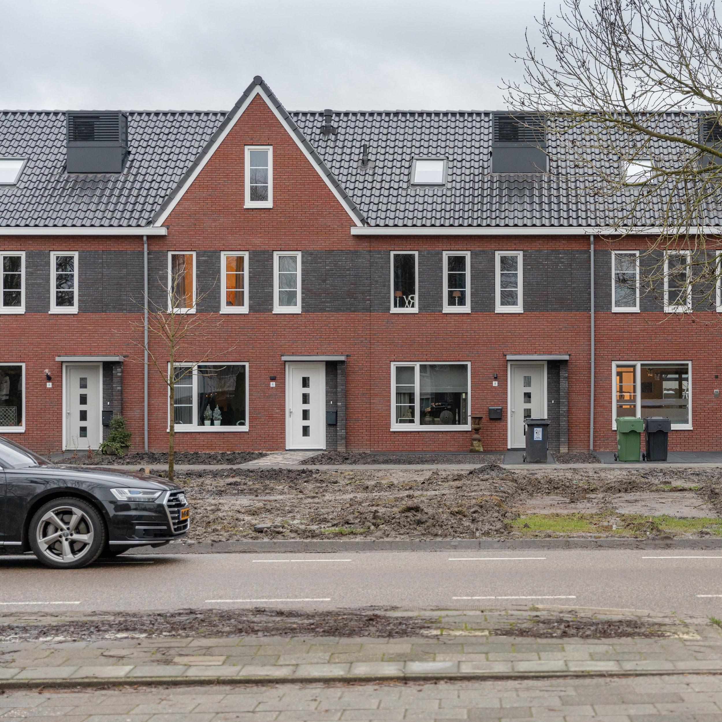
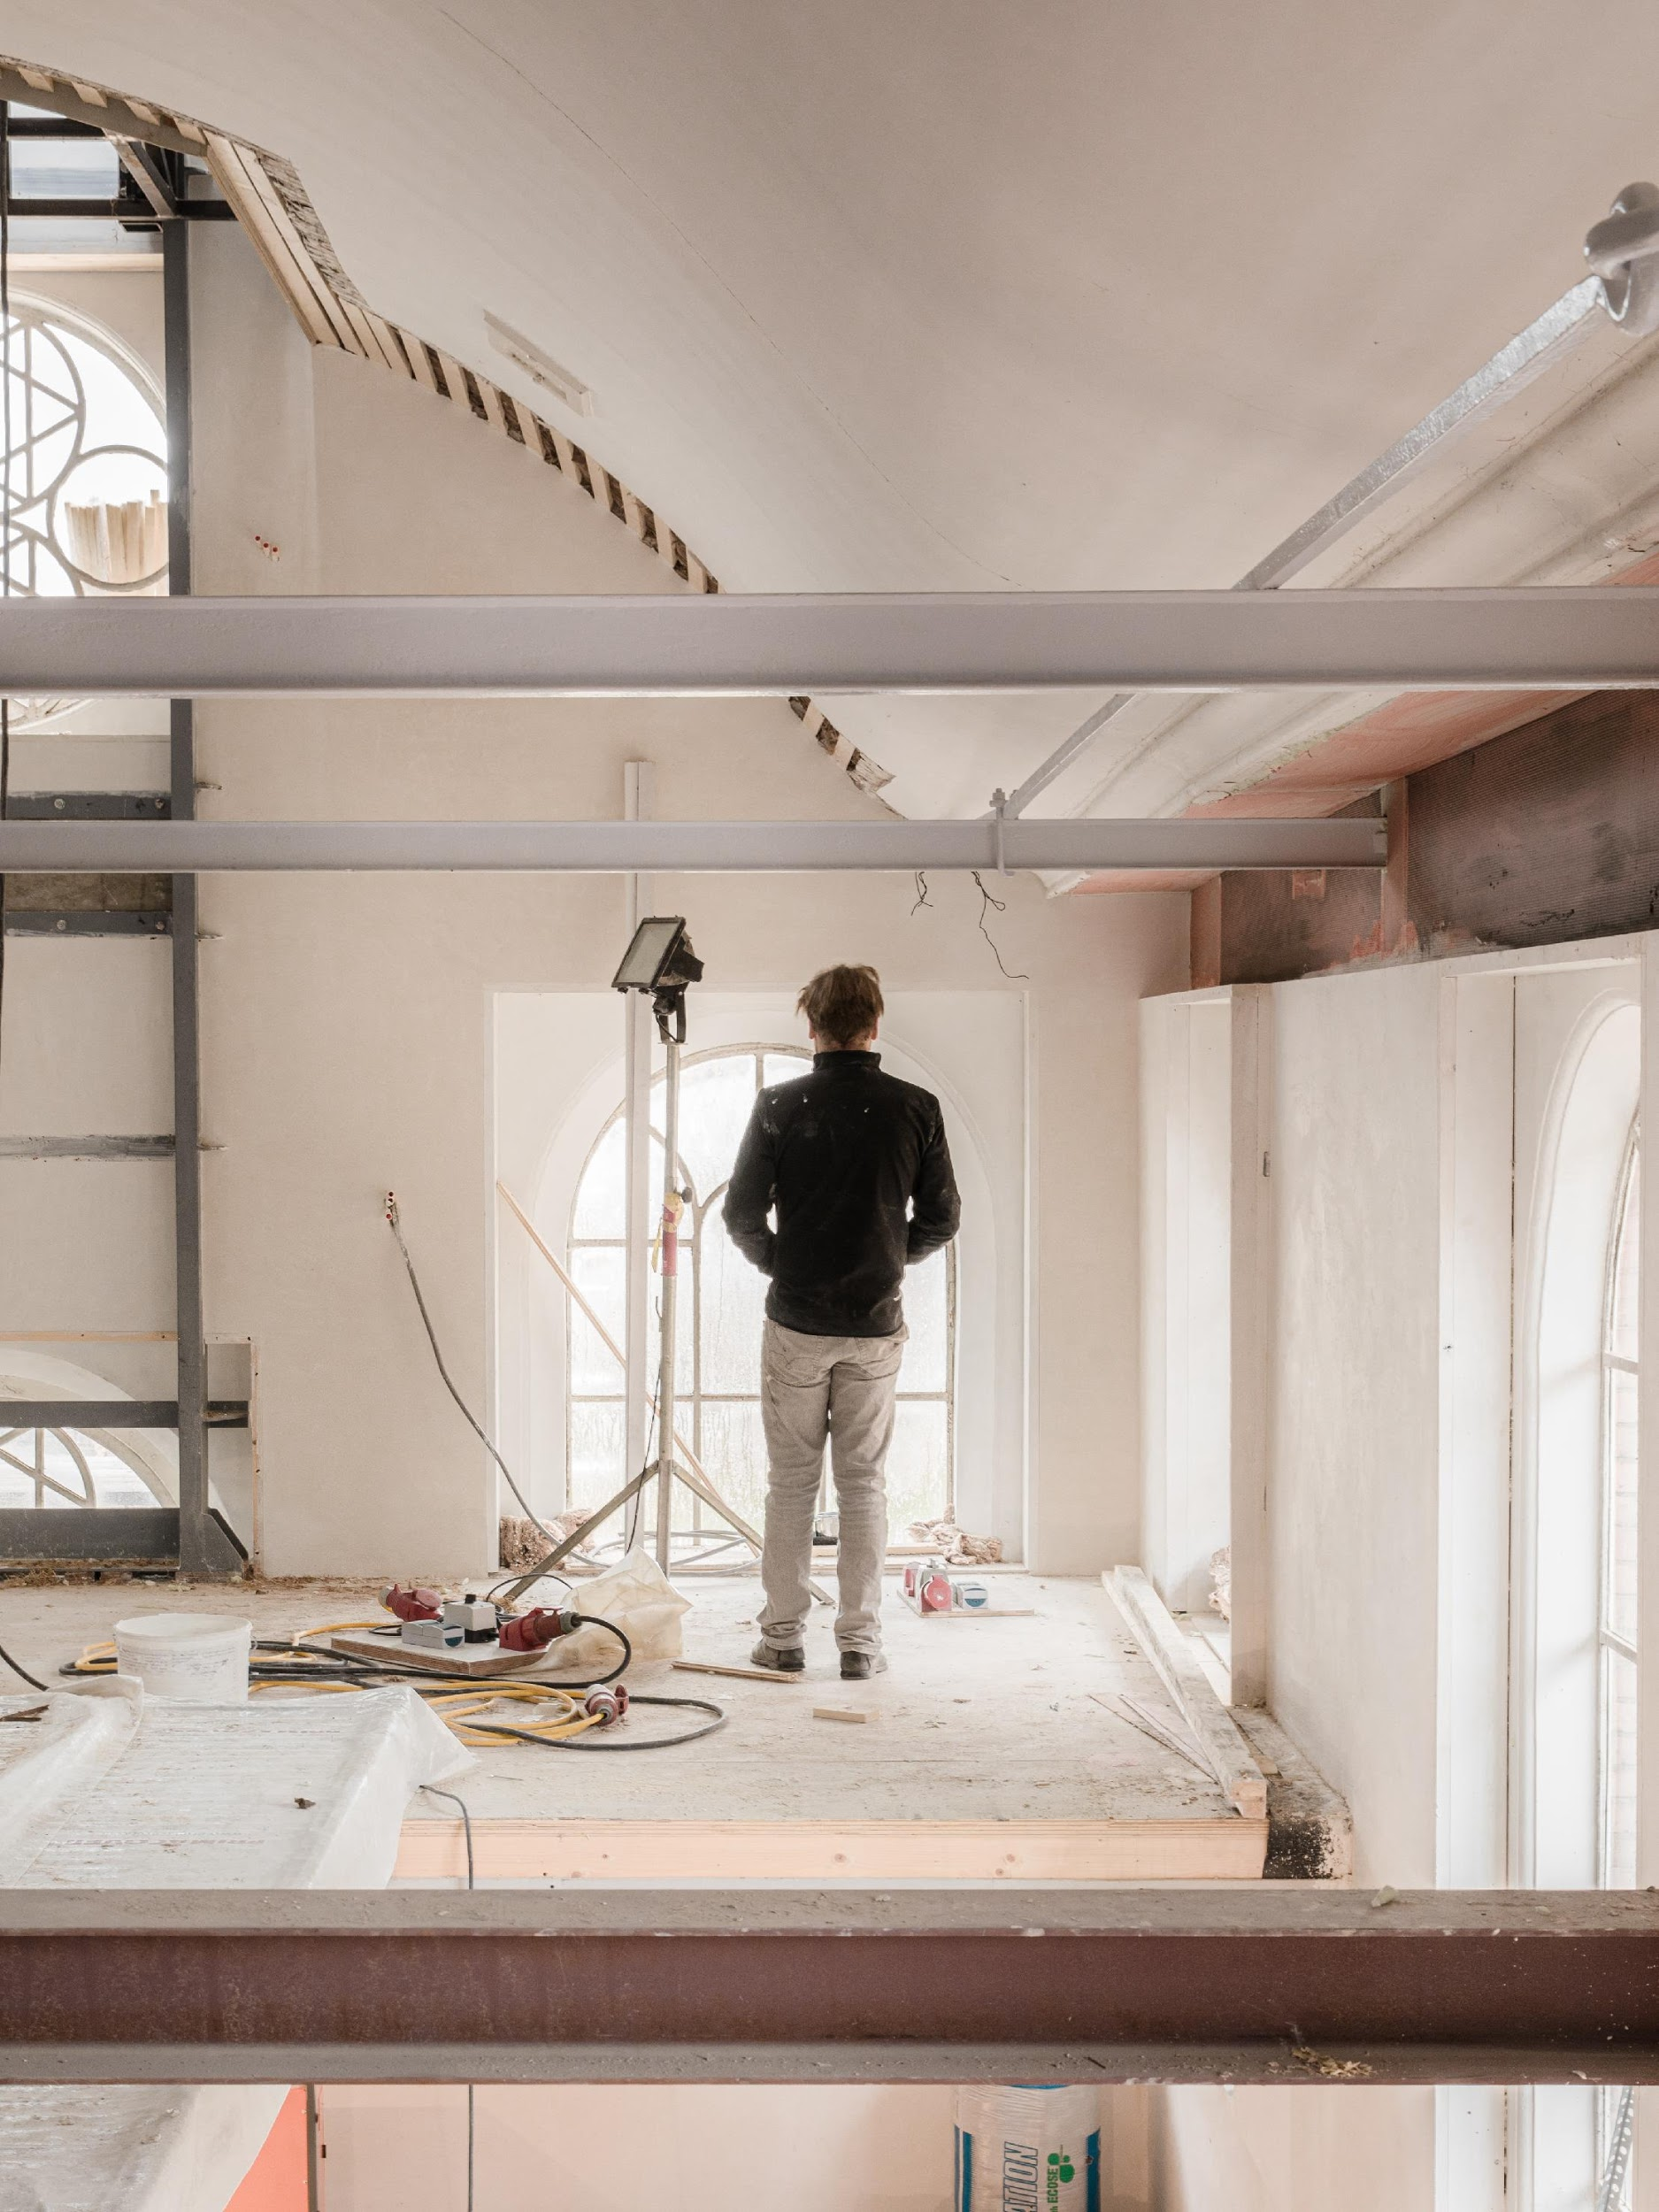
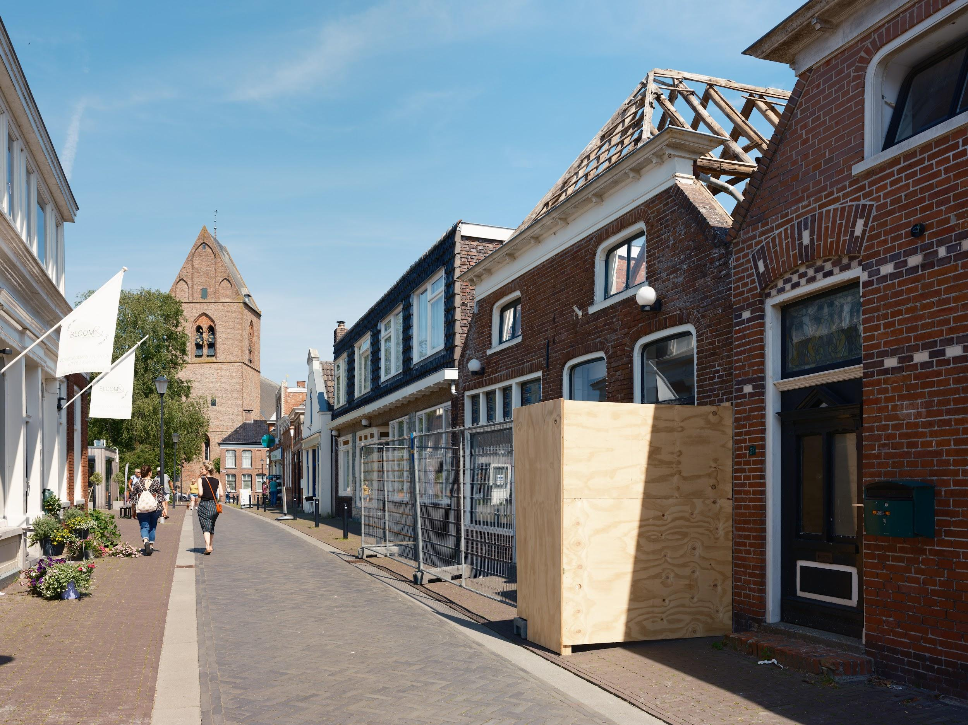
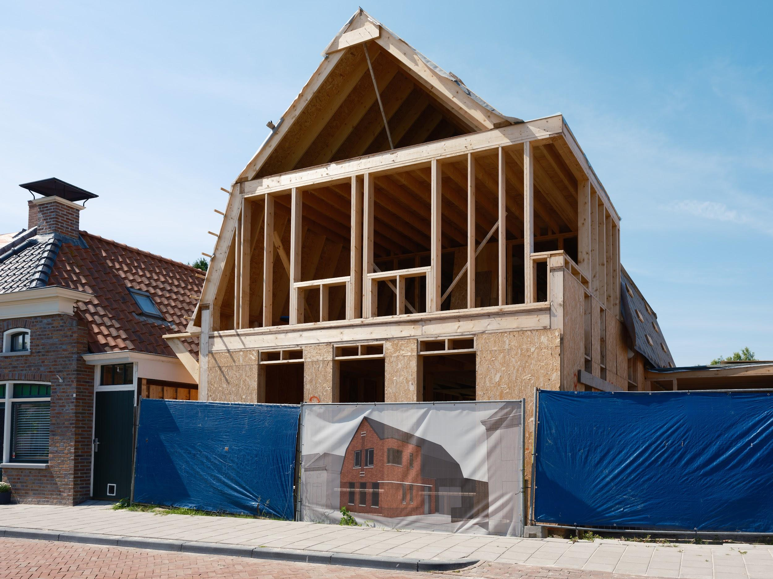

Slide 27
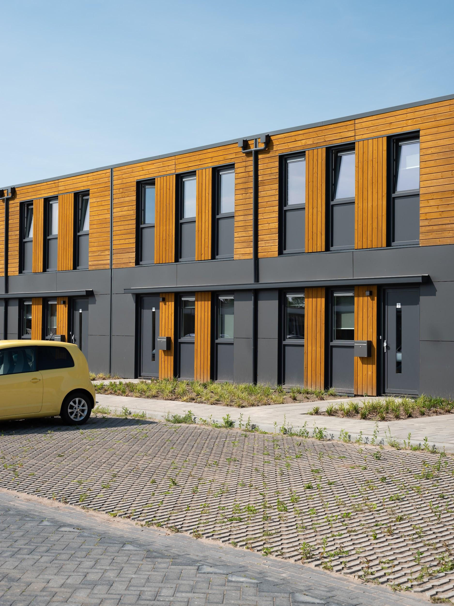
Immaterial impact
Time- and energy consuming processes:
Bureaucracy.
Repairs and reinforcement.
Temporary displacement of people.
Inequalities and loss of social cohesion.
Long-term insecurity.

Slide 28
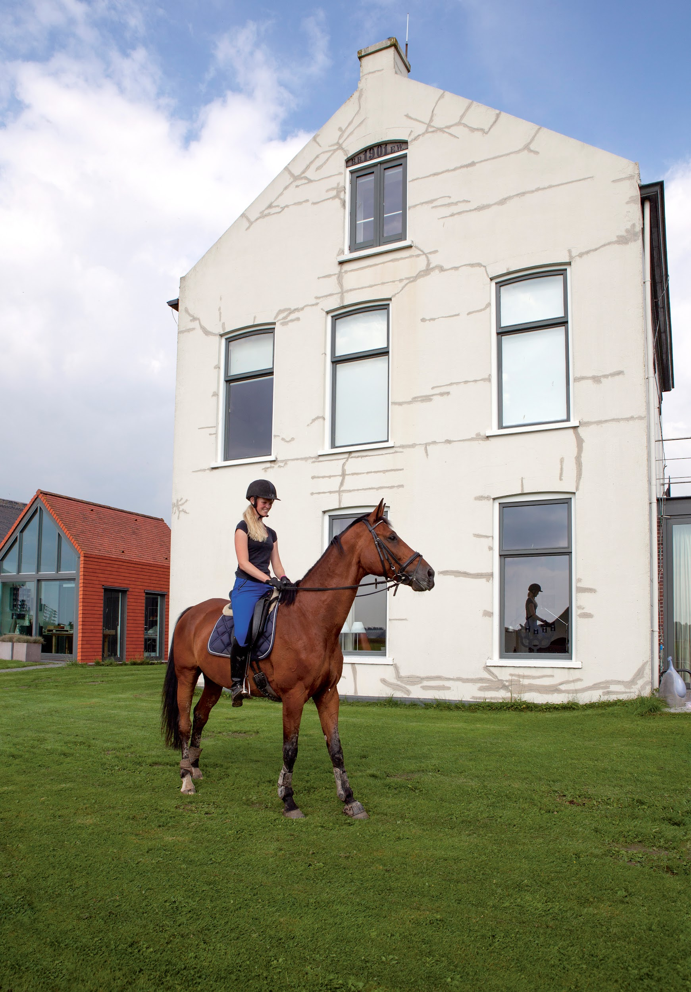
Health and wellbeing
Gronings Perspectief: quantitative and qualitative studies
Chronic stress, fear, insomnia, depression.
Frustration and powerlessness.
People with multiple damage claims feel significantly less
safe (Stroebe et al., 2022)
Children and young people experience similar health impact as adults.
Mistrust between citizens and government (and everyone else)

Slide 29
Challenges ahead
and lessons learned
Restoration of relations and regaining trust
Lessons learnt
The Parliamentary Inquiry

Slide 30
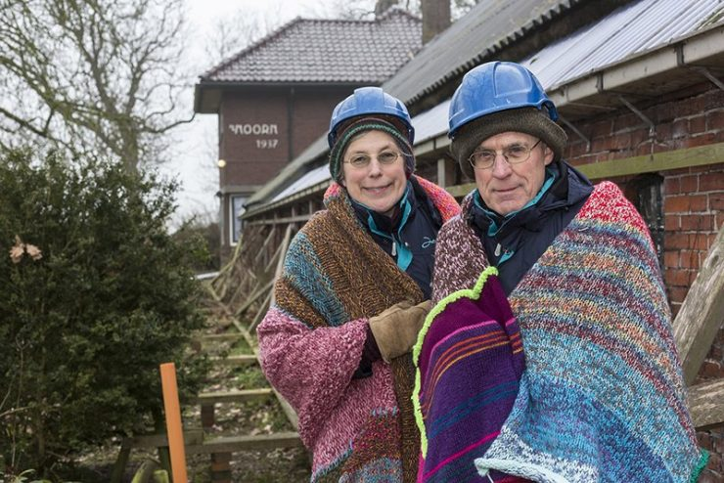
Restoration of relations and regaining trust
Relationships between citizens, governments and industry impacted by
denial of problems
broken promises
systemic changes
radical shifts in policy
years of uncertainty
Reconciliation and restoring trust vital.

Slide 31
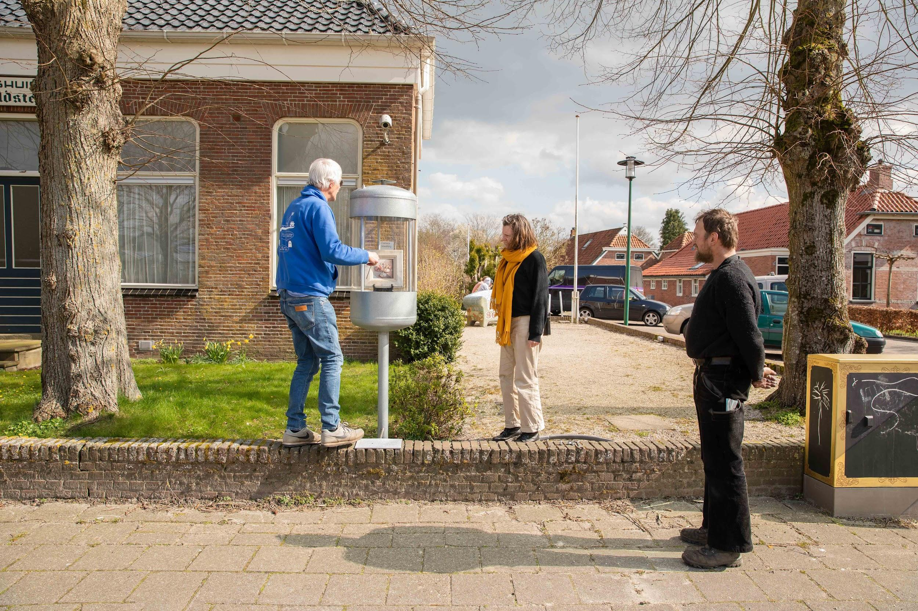
Lessons learnt
Money is not the solution.
Solution must be moral and ideological.
Participation and dialogue on different levels.
Integral approach to the restoration of safety and damages.
Non-repetition must be assured.
SIA beforehand. SLO crucial.

Slide 32
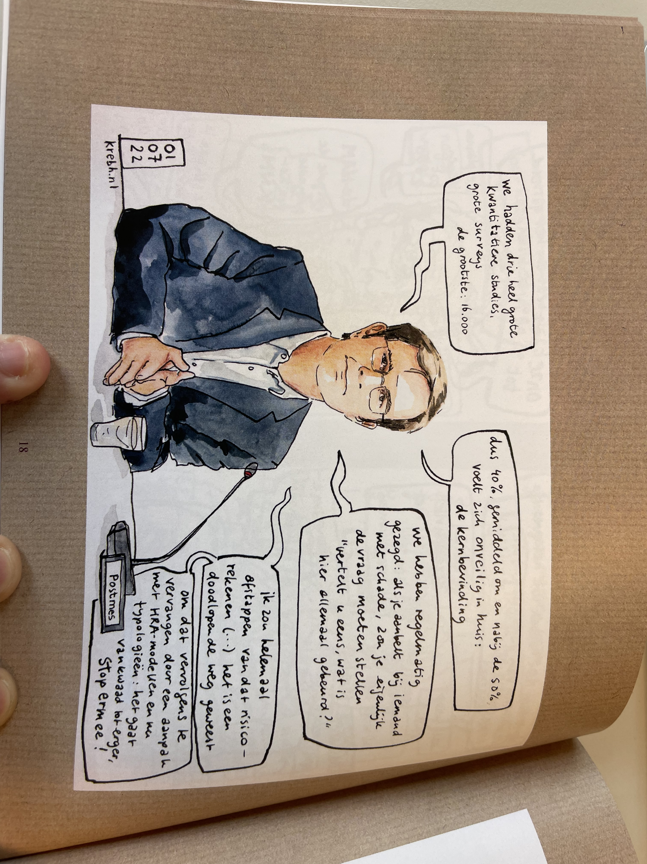
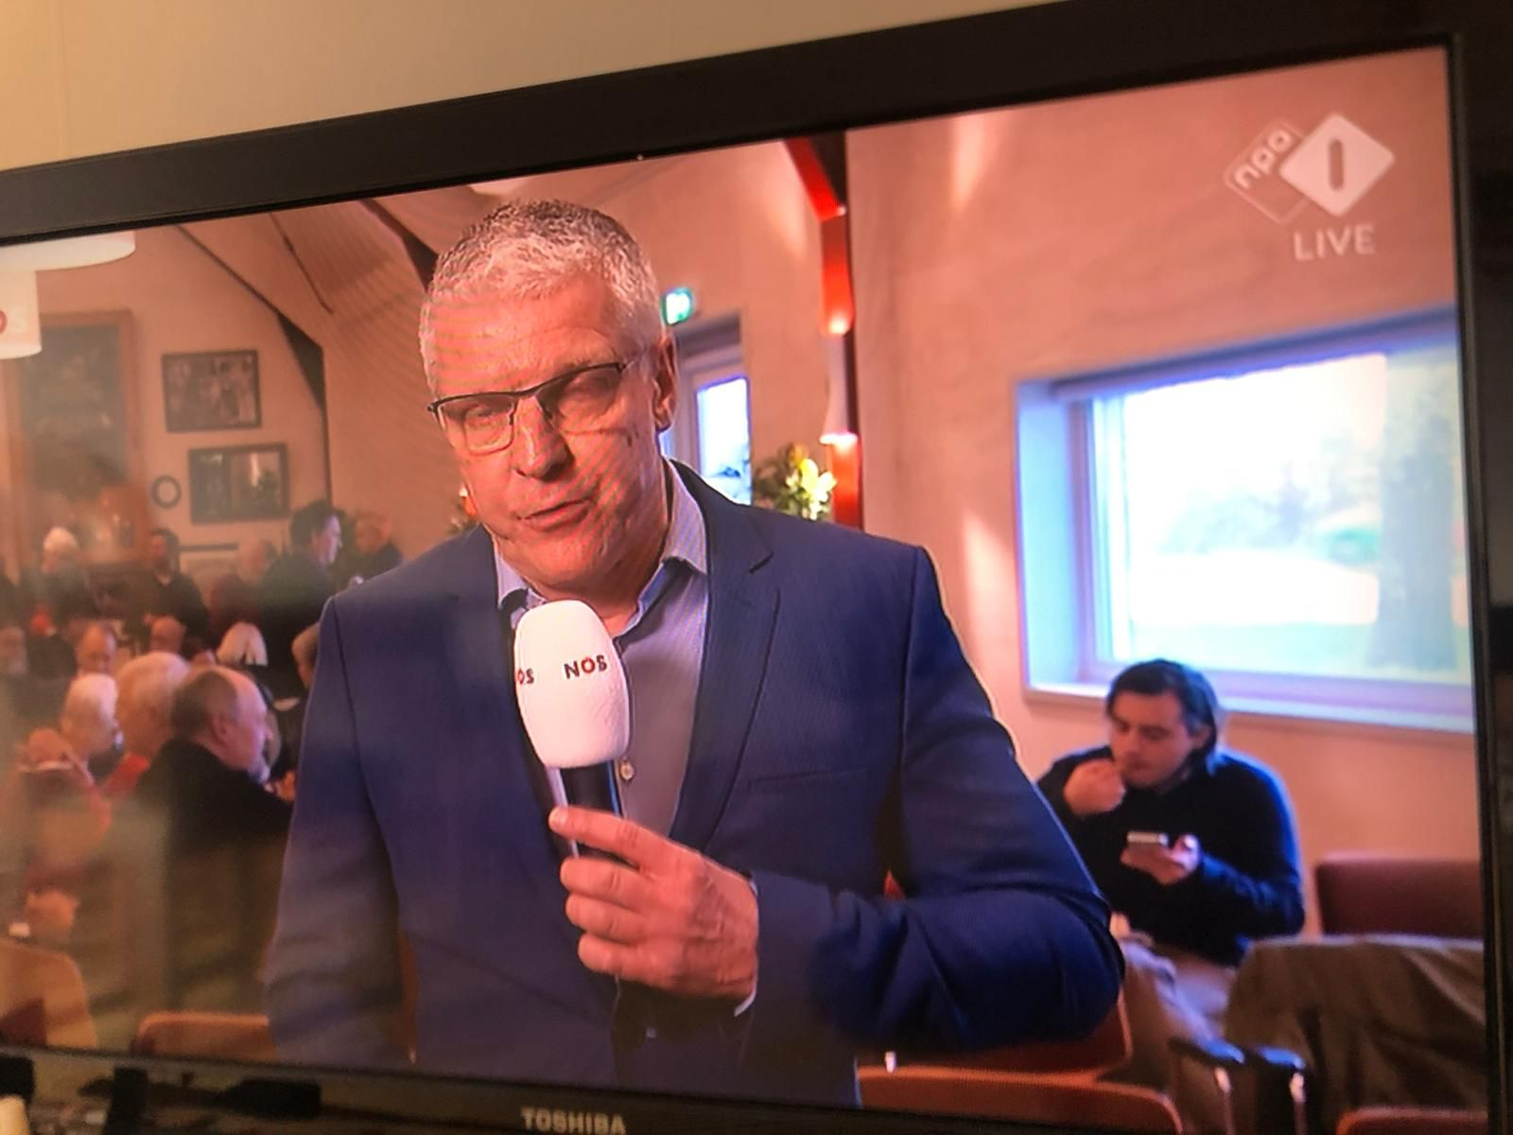
The Parliamentary Inquiry

Slide 33
Triggered by Parliament (House of Representatives, nd)
Participation is mandatory and under oath
Most serious instrument to inform Parliament better and enhance the quality of law-making (Muller & Coenen, 1997)
To initiate debates
To inform Parliament better
Control & evaluate policy
Political gain
Focus attention on policy issues
In the past: mostly informative role. Later, political chopping block. Today: complex systemic failures and restoring social cohesion (Wolffram, 2010)
Eg: Dutch participation in Srebrenica, toeslagenaffaire, Bijlmer disaster, corona
Parliamentary Inquiries: what are they? What can they become?

Slide 34
Relationships between all actors are damaged
Policy solutions haven’t improved the reality on the ground enough
Responsibility was kept diffuse – often on purpose
Local and regional governments have failed to represent its people sufficiently at critical moments
Unhealthy collusion between government and industry
Financial gain was put consistently above the interest of Groningers
Gov’t presented a plan as a response to the report
Will this government fall? What will the report achieve?
Parliamentary Inquiry: main findings

Slide 35
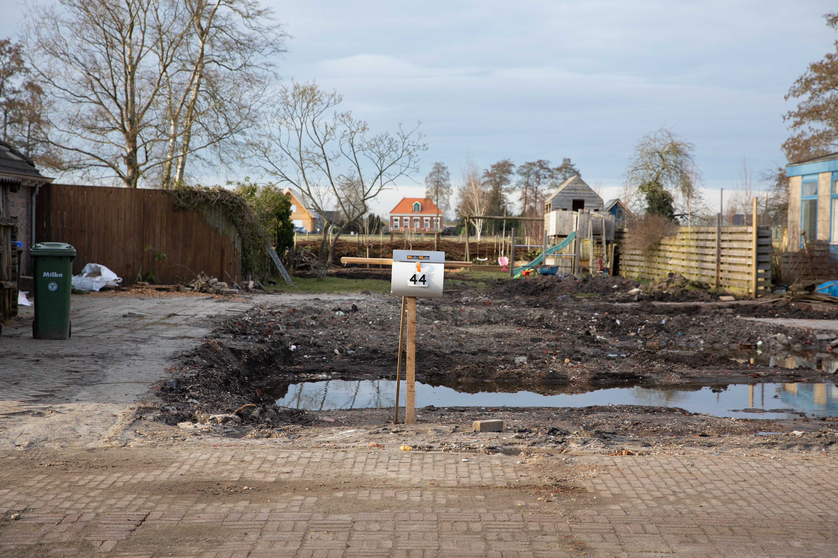
Vroagn? Dank & moi eem!
a.r.de.julio.pardo@rug.nl
www.kennisplatformleefbaar.nl
@KPleefbaar
@Kennisplatform
Kennisplatform Leefbaar en Kansrijk Groningen

